Slide 2
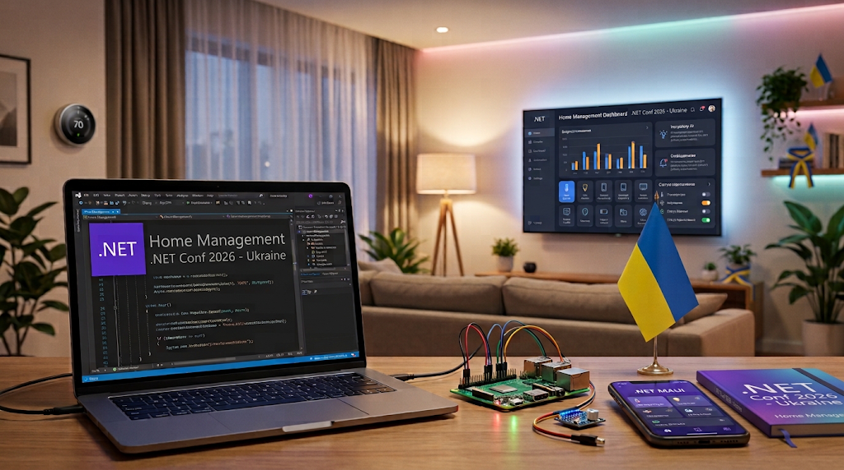
Vladislav Antonyuk
Rostyslav Skrypnyk
Andrey Tonkonog

Slide 3
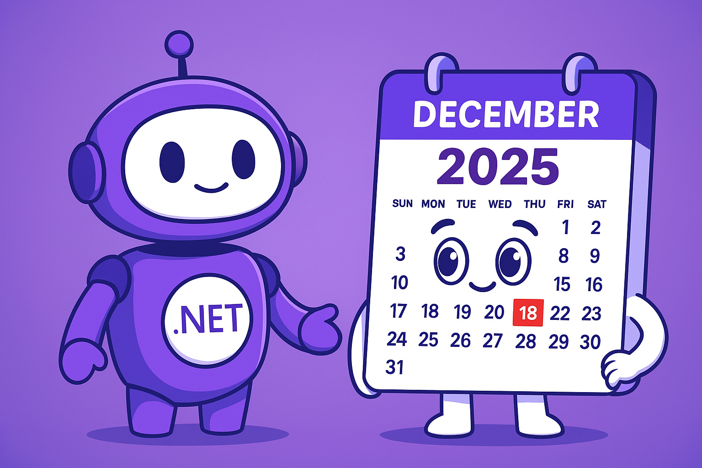
AI-Friendly Calendar!
AI Scheduling Assistant
Event Management
Cloud Sync
Multi-Platform Support
Notes:
Щоб найкраще розкрити весь потенціал .NET і продемонструвати нововведення було розроблено додаток AI-Calendar.
AICalendar is a cross-platform AI-powered calendar application built with .NET MAUI and Blazor. It helps users efficiently manage their schedules, appointments, and events with intelligent features and a modern user experience.

Slide 4
.NET 10
File base app
One-shot tool execution
https://devblogs.microsoft.com/dotnet/announcing-dotnet-10/

Slide 5
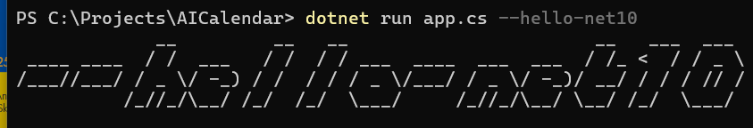
.NET 10 – file base app
#:package Colorful.Console@1.2.15 Colorful.Console.WriteAscii(args[0]); dotnet run app.cs | #:sdk Microsoft.NET.Sdk.Web #:sdk Aspire.AppHost.Sdk@9.4.1 #:property TargetFramework=net10.0 #:property LangVersion=preview #:package Aspire.Hosting.AppHost@9.4.1 #:package Colorful.Console@1.2.15 Colorful.Console.WriteAscii(args[0]);

Slide 6
.NET 10 – One-shot tool execution
One-shot tool execution allows you to run .NET tools directly without installing them globally or locally on your machine.
Before | After
# Install the tool globally dotnet tool install -g dotnetsay # Then run it dotnetsay "Hello, World!" | dotnet tool exec dotnetsay "Hello, World!“ #or dnx dotnetsay "Hello, World!"

Slide 7
.NET 10
File base app
One-shot tool execution
https://devblogs.microsoft.com/dotnet/announcing-dotnet-10/

Slide 8
C# 14
Extension members
Null-conditional assignment
nameof supports unbound generic types
More implicit conversions for Span<T> and ReadOnlySpan<T>
Modifiers on simple lambda parameters
field backed properties
partial events and constructors
User-Defined Compound Assignment Operators
Notes:
This reduces the need for explicit .AsSpan()

Slide 9
C# 14 – Extension members
public static class Enumerable { // Extension block extension<TSource>(IEnumerable<TSource> source) // extension members for IEnumerable<TSource> { // Extension property: public bool IsEmpty => !source.Any(); // Extension method: public IEnumerable<TSource> Where(Func<TSource, bool> predicate) { ... } } }
Notes:
In previous versions, C# already supported extensions, but they were limited to methods. Now, we can easily extend a type with properties, methods, events, and even introduce operators (except implicit and explicit operators).

Slide 10
C# 14 – Extension members
public static class Enumerable { // extension block, with a receiver type only extension<TSource>(IEnumerable<TSource>) // static extension members for IEnumerable<Source> { // static extension method: public static IEnumerable<TSource> Combine(IEnumerable<TSource> first, IEnumerable<TSource> second) { ... } // static extension property: public static IEnumerable<TSource> Identity => Enumerable.Empty<TSource>(); // static user defined operator: public static IEnumerable<TSource> operator + (IEnumerable<TSource> left, IEnumerable<TSource> right) => left.Concat(right); } }

Slide 11
C# 14 – Extension members
Before | After
public static Guid GetUserId(this ClaimsPrincipal claims) { Guid.TryParse(claims.GetObjectId(), out var currentUserId); return currentUserId; } | extension(ClaimsPrincipal claims) { public Guid GetUserId() { Guid.TryParse(claims.GetObjectId(), out var currentUserId); return currentUserId; } }

Slide 12
C# 14 – Null-conditional assignment
Before | After
public sealed class Account { public decimal Balance { get; set; } } public sealed class PaymentProccessor { public void Payout(Account? account, decimal amount) { if (account is not null) { account.Balance -= amount; } } } | public sealed class Account { public decimal Balance { get; set; } } public sealed class PaymentProccessor { public void Payout(Account? account, decimal amount) { account?.Balance -= amount; } }

Slide 13
C# 14 – nameof supports unbound generic types
You can pass an unbound generic type to nameof. Great for diagnostics, analyzers, and source generators.
Before | After
Console.WriteLine(nameof(List<int>)); // "List" Console.WriteLine(nameof(Dictionary<int, string>)); // "Dictionary" | Console.WriteLine(nameof(List<>)); // "List" Console.WriteLine(nameof(Dictionary<,>)); // "Dictionary"
Notes:
Beginning with C# 14, the argument to nameof can be an unbound generic type. For example, nameof(List<>) evaluates to List. In earlier versions of C#, only closed generic types, such as List<int>, could be used to return the List name.

Slide 14
C# 14 – the “field” keyword
Before | After
private string _msg; public string Message { get => _msg; set => _msg = value; } | public string Message { get; set => field = value; }

Slide 15
C# 14 – More partial members
In addition to partial methods/properties, you can define partial constructors and events with defining and implementing declarations.
Defining declarations | Implementing declarations
public partial class Widget { public partial Widget(string name); public partial event EventHandler? Started; } | public partial class Widget { private string _name; public partial Widget(string name) : this() { _name = name; } public partial event EventHandler? Started { add { /* add logic */ } remove { /* remove logic */ } } }

Slide 16
C# 14
Extension members
Null-conditional assignment
nameof supports unbound generic types
More implicit conversions for Span<T> and ReadOnlySpan<T>
Modifiers on simple lambda parameters
field backed properties
partial events and constructors
User-Defined Compound Assignment Operators
Notes:
This reduces the need for explicit .AsSpan()

Slide 17
ASP.NET CORE
Validation support in minimal APIs
Web Authentication (Passkey) Support
Support for Server-Sent Events
app.MapGet("/notifications", (IRandomizerString randomizer, CancellationToken token) => { return TypedResults.ServerSentEvents(GetNotificationsAsync(randomizer, token), "notification"); async IAsyncEnumerable<NotificationEvent> GetNotificationsAsync( IRandomizerString randomizerString, [EnumeratorCancellation] CancellationToken cancellationToken) { while (!cancellationToken.IsCancellationRequested) { await Task.Delay(4000, cancellationToken); yield return new NotificationEvent(Guid.CreateVersion7(), randomizerString.Generate()); } } });

Slide 18
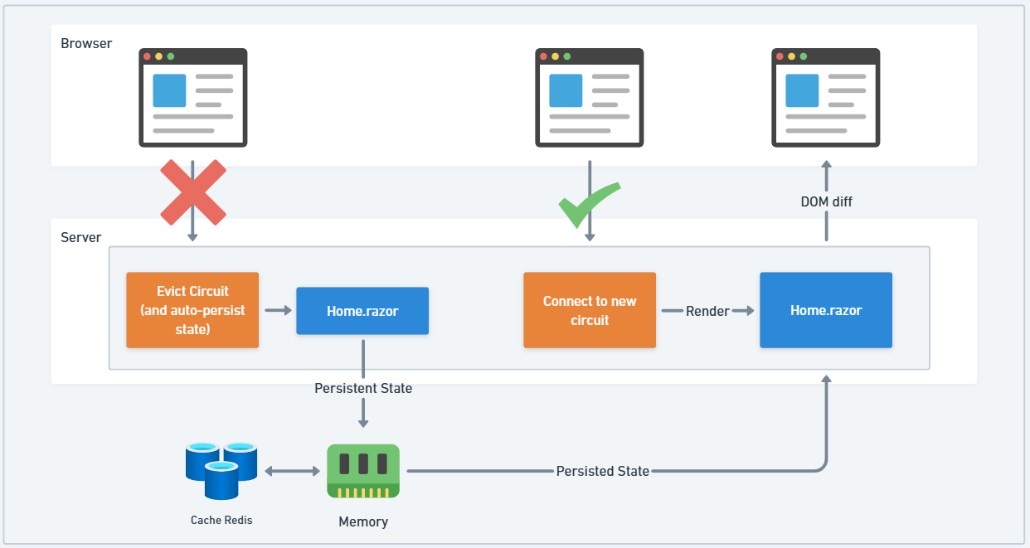
Blazor
Persistent Component State – [PersistentState]
Improved “Not Found” Handling
Customizable Reconnection Modal
Fingerprinted and Compressed Blazor Scripts
New Metrics for Blazor
New APIs for Controlling Blazor Server Connections

Slide 19
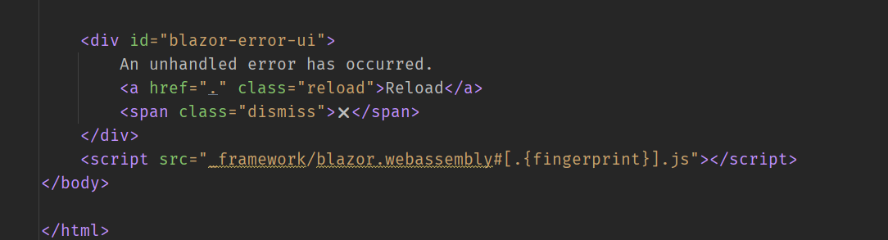
Blazor
Persistent Component State – [PersistentState]
Improved “Not Found” Handling
Customizable Reconnection Modal
Fingerprinted and Compressed Blazor Scripts
New Metrics for Blazor
New APIs for Controlling Blazor Server Connections

Slide 20
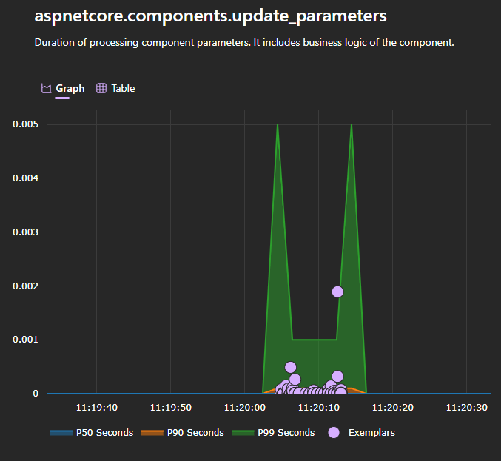
Blazor
Persistent Component State – [PersistentState]
Improved “Not Found” Handling
Customizable Reconnection Modal
Fingerprinted and Compressed Blazor Scripts
New Metrics for Blazor
New APIs for Controlling Blazor Server Connections

Slide 21
Blazor
Persistent Component State – [PersistentState]
Improved “Not Found” Handling
Customizable Reconnection Modal
Fingerprinted and Compressed Blazor Scripts
New Metrics for Blazor
New APIs for Controlling Blazor Server Connections
document.addEventListener('visibilitychange', ()=> {
if(document.hidden) {
console.debug("Document hidden - pausing Blazor");
Blazor.pauseCircuit();
} else {
console.debug("Document visible - resuming Blazor");
Blazor.resumeCircuit();
}
});

Slide 22
.NET MAUI 10
Aspire integration
Android 16/iOS 26 Support
Focus on quality
Performance improvements
CollectionView/CarouselView enhancements
New APIs: Shadows, Switch OffColor, and more
MediaPicker modernization
MessagingCenter is removed! Again!
ListView, TableView and Cells deprecated
And More... https://learn.microsoft.com/en-us/dotnet/maui/whats-new/dotnet-10

Slide 23
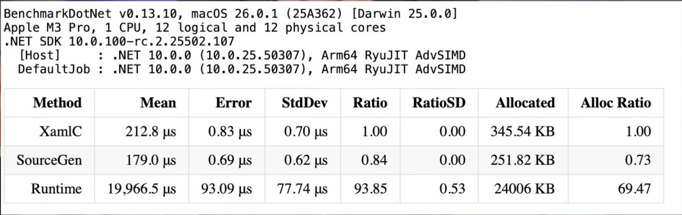
.NET MAUI 10
XAML Source Generation

Slide 24
.NET MAUI 10
XAML Global Namespaces
XAML Implicit Namespaces
Before | After
<ContentPage xmlns="http://schemas.microsoft.com/dotnet/2021/maui" xmlns:x="http://schemas.microsoft.com/winfx/2009/xaml" xmlns:models="clr-namespace:MyApp.Models" xmlns:controls="clr-namespace:MyApp.Controls" x:Class="MyApp.MainPage"> <controls:TagView x:DataType="models:Tag" /> </ContentPage> | <ContentPage x:Class="MyApp.MainPage"> <TagView x:DataType="Tag" /> </ContentPage>

Slide 25
EntityFramework Core
Support LeftJoin and RightJoin operator
JSON type
Before | After
var query = students .GroupJoin( departments, student => student.DepartmentID, department => department.ID, (student, departmentList)=> new{ student, subgroup = departmentList }) .SelectMany( joinedSet => joinedSet.subgroup.DefaultIfEmpty(), (student, department) => new { student.student.FirstName, student.student.LastName, Department = department.Name ?? "[NONE]" }); | var query = students .LeftJoin( departments, student => student.DepartmentID, department => department.ID, (student, department) => new { student.FirstName, student.LastName, Department = department.Name ?? "[NONE]" });

Slide 26

Templates
https://www.nuget.org/packages/VladislavAntonyuk.DotNetTemplates

Slide 27
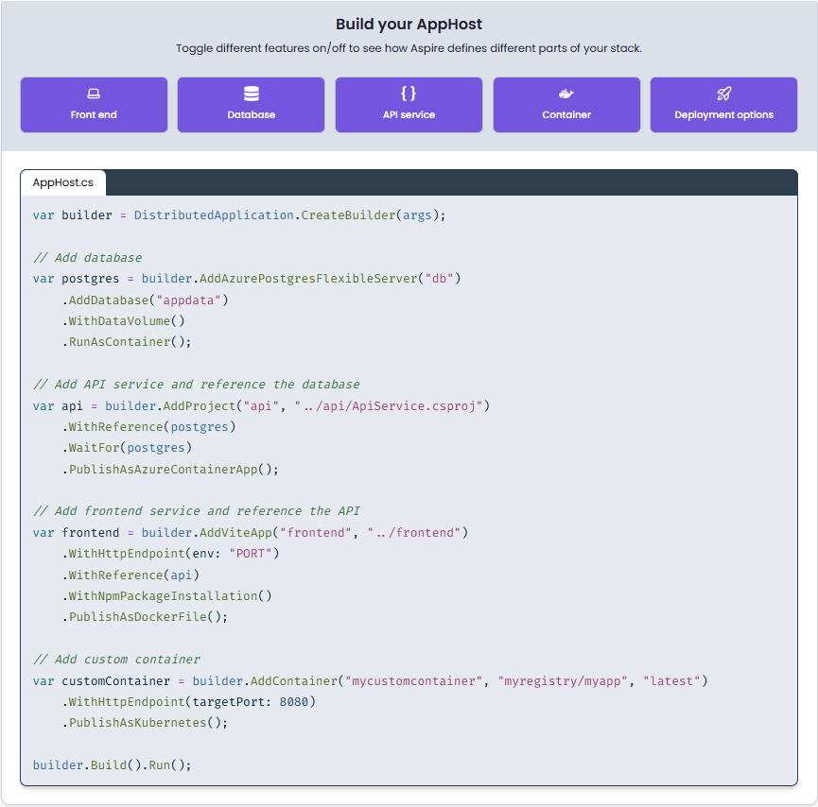
Overview of ASPIRE

Slide 28
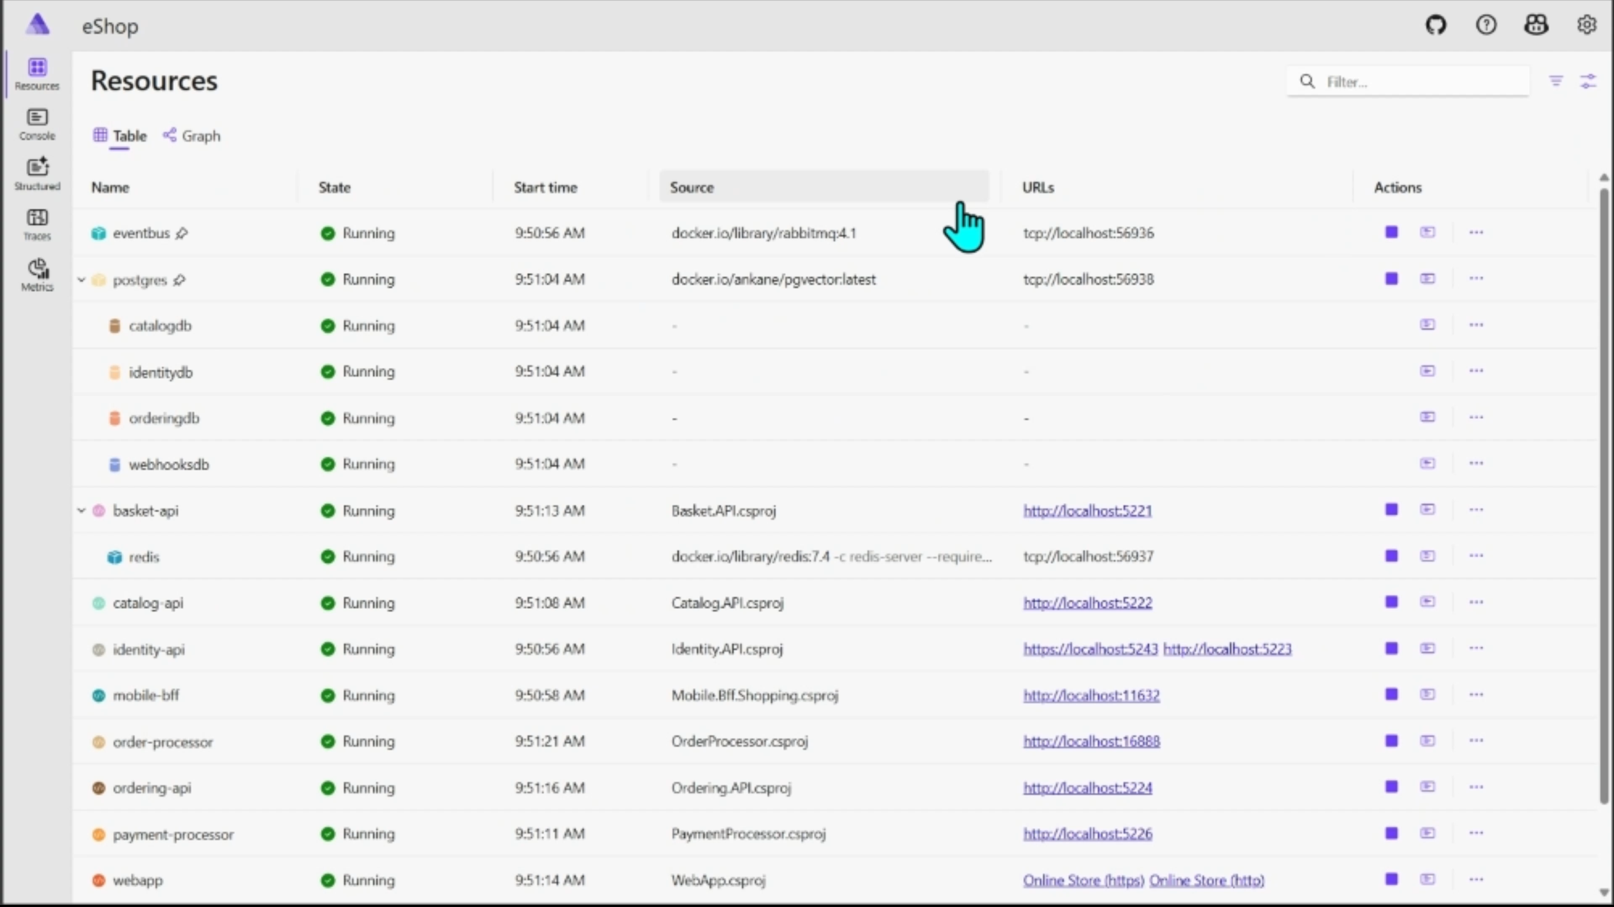
Overview of ASPIRE

Slide 29
What’s new on Aspire 13
First-class Python support
First-class JavaScript support
Polyglot infrastructure
Container files as build artifacts
aspire do
Modern CLI
VS Code extension
Notes:
First-class Python support: Support for Python modules, deploy with uvicorn, flexible package management (uv, pip, or venv), and generate production Dockerfiles automatically.
First-class JavaScript support : Vite and npm-based apps with package manager auto-detection, debugging support, and container-based build pipelines.
Polyglot infrastructure: Connection properties work in any language (URI, JDBC, individual properties), certificate trust across languages and containers.
Container files as build artifacts: A new paradigm where build outputs are containers, not folders - enabling reproducible, isolated, and portable builds.
aspire do: a new platform for build, publish and deployment pipelines: enabling parallel execution, dependency tracking, and extensible workflows for building, publishing, and deploying applications.
Modern CLI: aspire init to Aspirify existing apps, and improved deployment state management that remembers your configuration across runs.
VS Code extension: Streamlined Aspire development with commands for project creation, integration management, multi-language debugging, and deployment.

Slide 30

Visual Studio 2026
AI built into the IDE
Insiders Channel
Performance improvements
UI refresh
Editor and productivity updates
Copilot context actions
BenchmarkDotNet template
Hot Reload improvements for Razor
Notes:
GetUserHandler

Slide 31
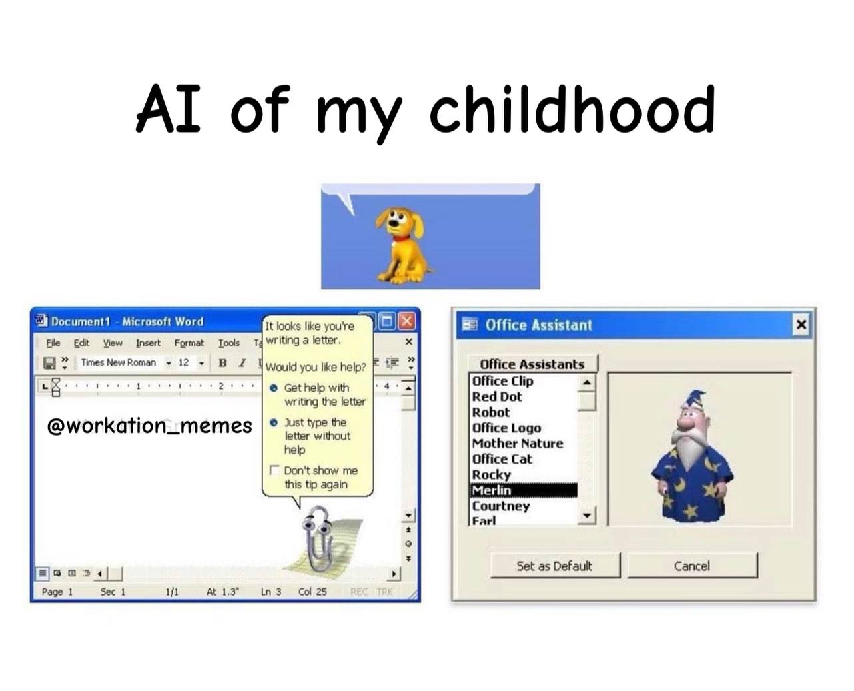
Visual Studio 2026 – GitHub Copilot Improvements
Bring your own model to chat (custom LLMs via API keys).
Adaptive paste: Copilot adjusts pasted code to fit context.
Copilot actions in context menu (explain, optimize, comment, test, add to chat).
“Did you mean?” Copilot-powered search suggestions.
Mermaid chart rendering in Markdown editor and Copilot Chat.
Copilot URL context: paste a URL in chat to pull in page content.
Better Copilot responses: improved code search, external symbol awareness, and line number accuracy.

Slide 32

Visual Studio 2026 – IDE & UI
Code coverage now available in Community and Professional editions.
New look and feel: Fluent UI design, new themes, and iconography.
Modern settings experience: streamlined, user-friendly settings UI.

Slide 33

Visual Studio 2026 – AI Profiler
An AI-assisted profiler that goes beyond showing performance bottlenecks — it uses real traces and benchmarks and can suggest prioritized fixes. Also supports natural-language queries to guide profiling.

Slide 34
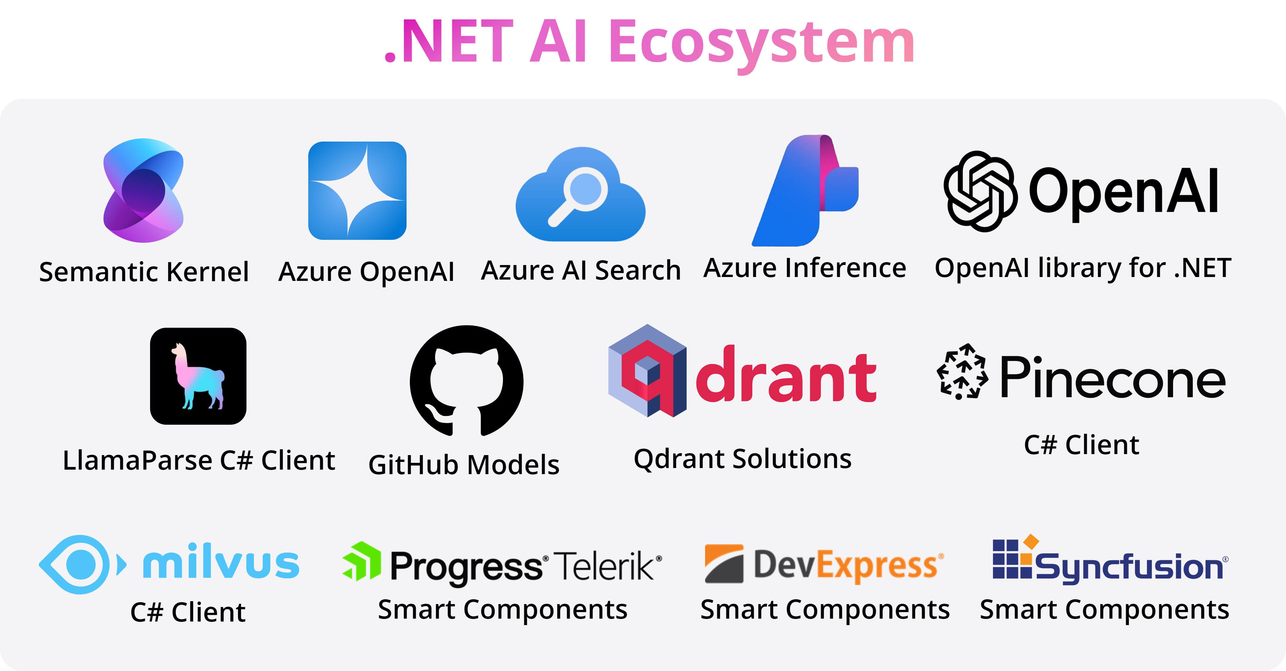
Artificial Intelligence and .NET

Slide 35
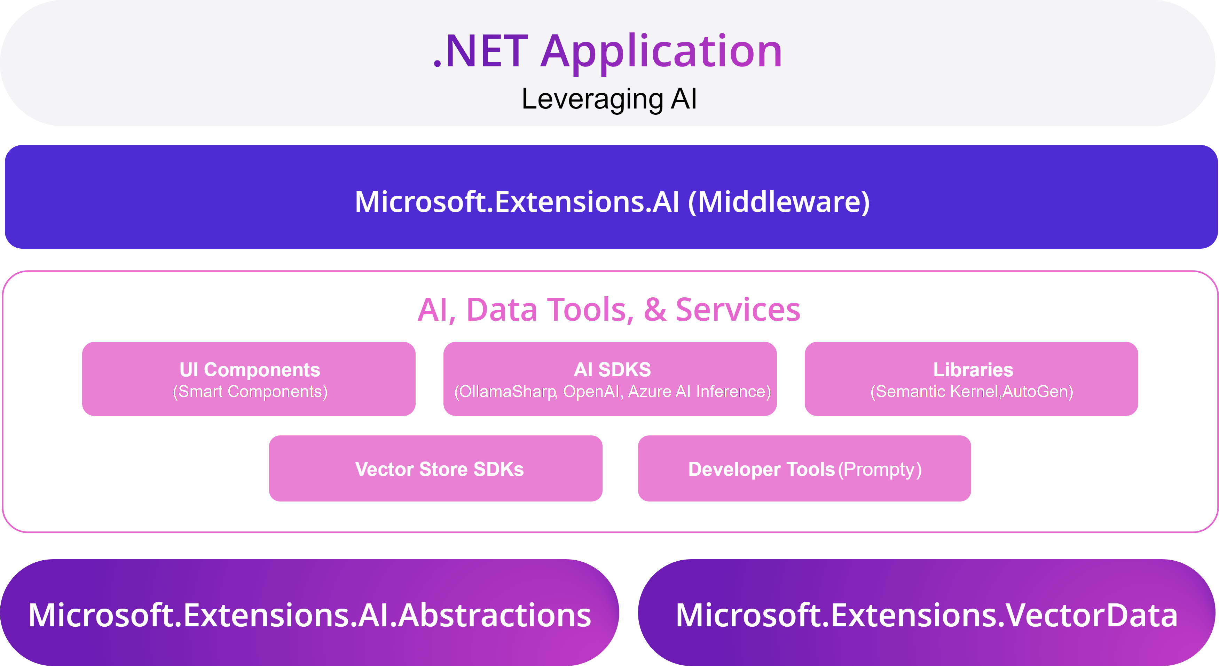
Artificial Intelligence and .NET

Slide 36
MCP, AI, .NET
Your computer
MCP Protocol
MCP Server A
Local
Data Source A
Internet
Host
(VS Code, IDEs)
Client
(GitHub Copilot)
MCP Server B
MCP Protocol
Web APIs
Local
Data Source B
MCP Protocol (SSE)
Remote
Remote Server
Web APIs
Remote
Service C
Notes:
MCP C# SDK

Slide 37
AI Agents
An artificial intelligence (AI) agent is a software program that can interact with its environment, collect data, and use that data to perform self-directed tasks that meet predetermined goals.
AI agents work by simplifying and automating complex tasks. Most autonomous agents follow a specific workflow when performing assigned tasks.
Determine goals
Acquire information
Implement tasks

Slide 38
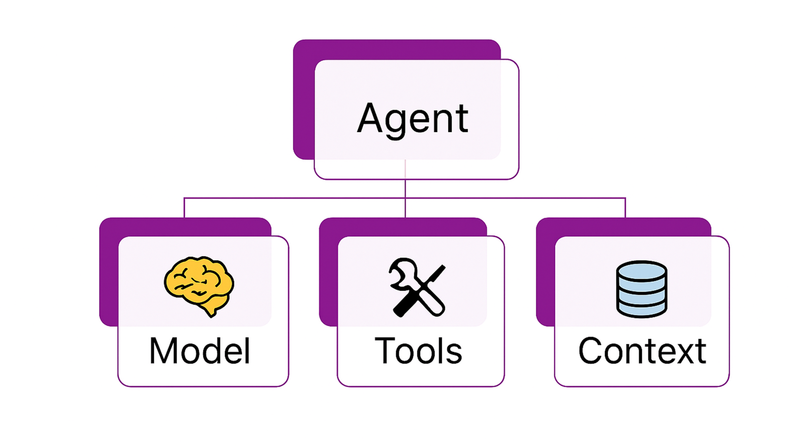
AI Agents

Slide 39
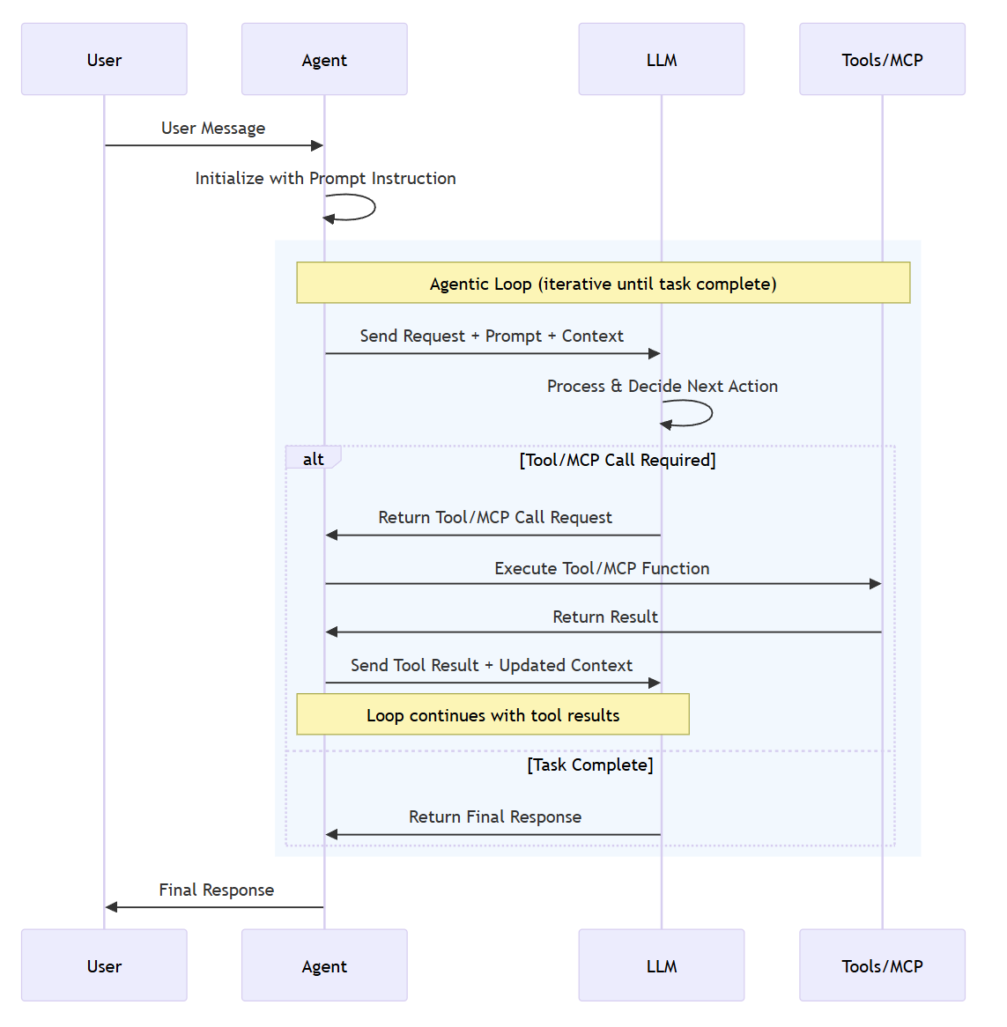
AI Agents
Notes:
Microsoft Agent Framework

Slide 40
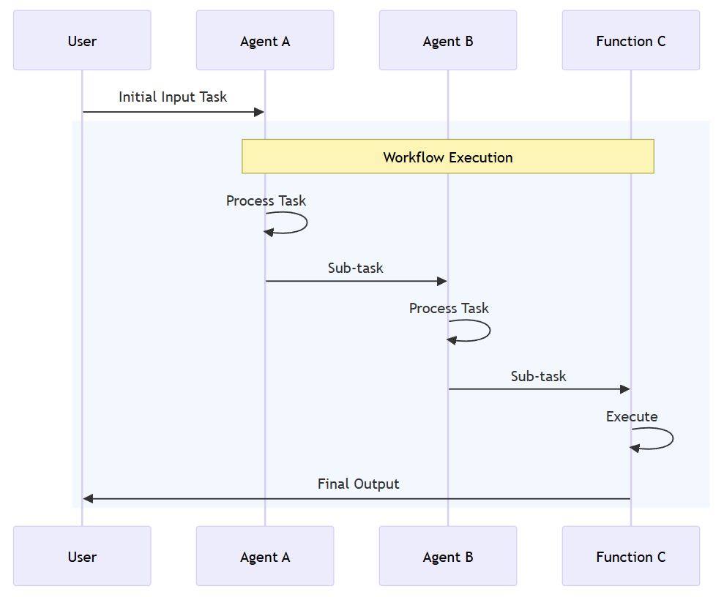
AI Agents – Workflow
A workflow can express a predefined sequence of operations that can include AI agents as components while maintaining consistency and reliability. Workflows are designed to handle complex and long-running processes that might involve multiple agents, human interactions, and integrations with external systems.

Slide 41
AI Evaluation
📦 Microsoft.Extensions.AI.Evaluation – Defines the core abstractions and types for supporting evaluation.
📦 Microsoft.Extensions.AI.Evaluation.NLP - Contains evaluators that evaluate the similarity of an LLM's response text to one or more reference responses using natural language processing (NLP) metrics. These evaluators aren't LLM or AI-based; they use traditional NLP techniques such as text tokenization and n-gram analysis to evaluate text similarity.
📦 Microsoft.Extensions.AI.Evaluation.Quality – Contains evaluators that assess the quality of LLM responses in an app according to metrics such as relevance and completeness. These evaluators use the LLM directly to perform evaluations.
📦 Microsoft.Extensions.AI.Evaluation.Safety – Contains evaluators, such as the ProtectedMaterialEvaluator and ContentHarmEvaluator, that use the Azure AI Foundry evaluation service to perform evaluations.
📦 Microsoft.Extensions.AI.Evaluation.Reporting – Contains support for caching LLM responses, storing the results of evaluations, and generating reports from that data.
📦 Microsoft.Extensions.AI.Evaluation.Reporting.Azure – Supports the reporting library with an implementation for caching LLM responses and storing the evaluation results in an Azure Storage container.
📦 Microsoft.Extensions.AI.Evaluation.Console – A command-line tool for generating reports and managing evaluation data.

Slide 42
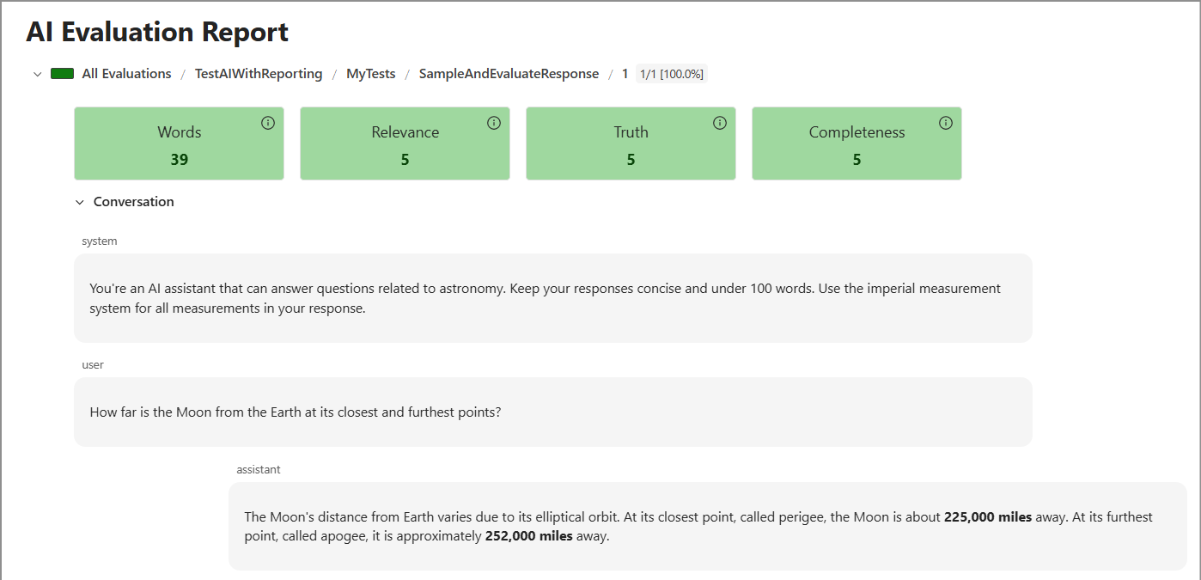
AI Evaluation

Slide 43
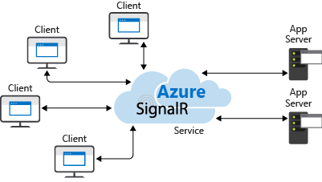
SignalR
SignalR is an open-source library for adding real-time web functionality to .NET applications, enabling server-to-client communication without requiring the client to constantly poll for updates.

Slide 44
SignalR - when to use:
Apps that require high frequency updates from the server
Dashboards and monitoring apps
Collaborative apps
Apps that require notification
Notes:
Apps that require high frequency updates from the server. Examples are gaming, social networks, voting, auction, maps, and GPS apps.
Dashboards and monitoring apps. Examples include company dashboards, instant sales updates, or travel alerts.
Collaborative apps. Whiteboard apps and team meeting software are examples of collaborative apps.
Apps that require notification. Social networks, email, chat, games, travel alerts, and many other apps use notifications.

Slide 45
Links and Samples
.NET 10 Overview
Aspire docs
.NET AI Overview
AICalendar Source

